Slide 1
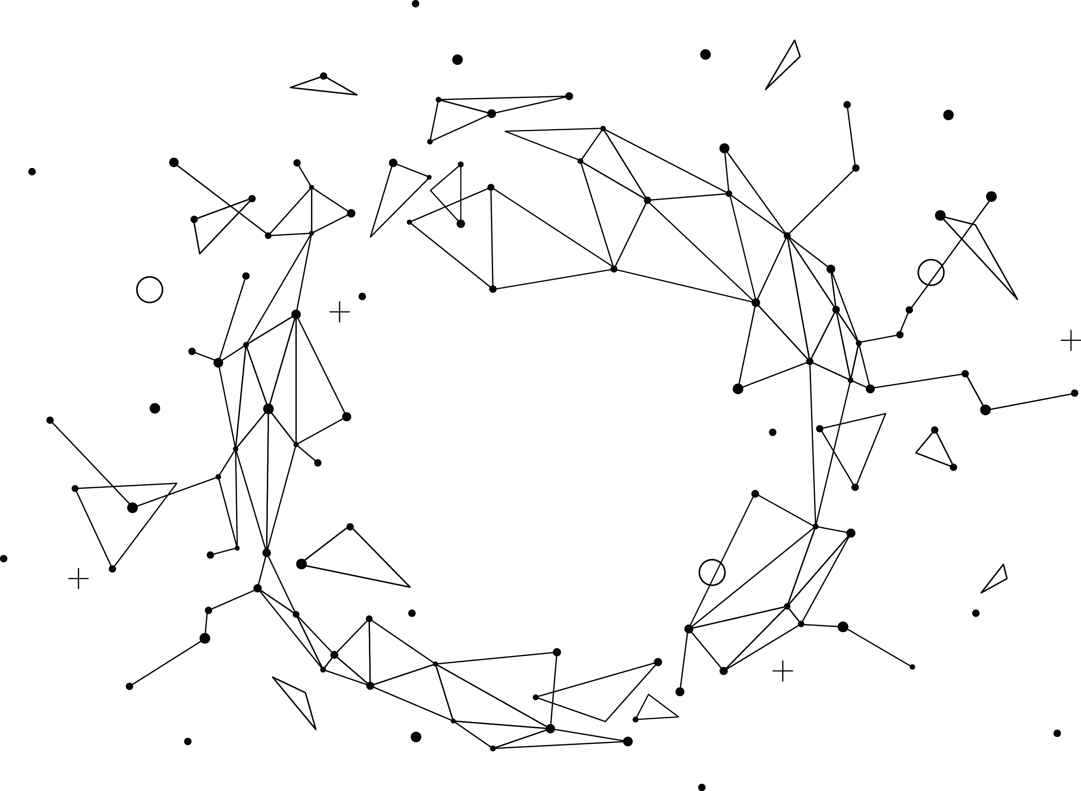
Pattern recognition
Mini Project 1
B10500012 鍾佳欽

Slide 2
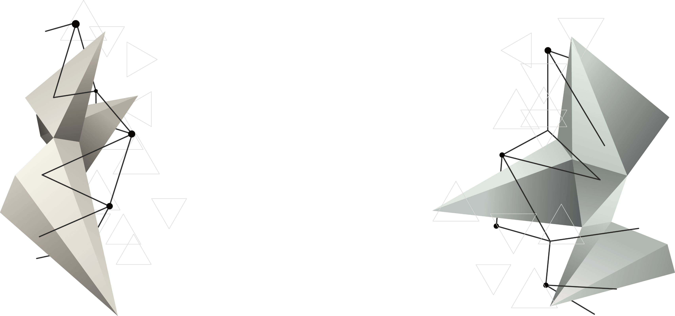
CONTENT
04
Conclusions
Three Questions
01
03
Draw Charts By Excel
02
Program Code (C/C++)

Slide 3
1
問題
Memories, beautiful very hurt, memories, memories of the past but can not go back.You can be happy to live just by yourself.

Slide 4
01
Three Cases
Case1
d = 100 and n =100 using a simulated coin with q = ¼ and ½.
Case2
d = 10 and n =1000 using a simulated coin with q = ¼ and 1/3.
Case3
d = 100 and n = 1000 using a simulated coin with q = ¼ and 1/3.

Slide 5
2
程式碼 (C/C++)

Slide 6
程式碼(C/C++)
02
#include <iostream>
#include <cstdlib>
#include <ctime>
#include <math.h>
#include <random>
using namespace std;
int main(){
random_device rd; //使用產生的亂數來做為亂數種子
mt19937 generator( rd() ); //亂數產生器: 梅森旋轉演算法
int a; //出現正面的機率
cout << "出現正面的機率: " ;
cin >> a;
double p = a*0.01;
cout << "擲硬幣次數: ";
int n ; //擲硬幣次數
while(cin >> n && n > 0)
{
double mean = n * p; //平均值
double std9 = sqrt((n*p)*(1-p)); //標準差
/* 常態分布函數 */
normal_distribution<double> norm(mean, std9);
//(期望值,標準差) ， 位置參數(決定了分布的位置)與尺度參數(決
定了分布的幅度)
/* 常態分布亂數直方圖 */
int r[n+1]={};
srand( time(NULL) ); //固定亂數種子
int m = 0 ,y = 1;

Slide 7
程式碼(C/C++)
02
//測試的次數n
cout << "n: " ;
int quiz;
cin >> quiz;
cout << endl;
for (int i=0; i < quiz; ++i) {
double x = norm(generator);
if ((x >= 0.0) && (x <= n)) ++r[int(x)]; //計數
int pr = x; // 出現正面的次數
//cout << "第" << i+1 << "次測試結果:" << endl;
int test1 = 0, test2 = 0;
while((test1+test2) != n){
int num = rand() % (y - m + 1) + m;
/* 產生 [0 , 1] 的整數亂數 */
if(num == 1 && test1 < pr)
{
//cout << "num = " << num << endl;
test1 ++;
}
else if(num == 0 && test2 < n-pr)
{
//cout << "num = " << num << endl;
test2 ++;
}
}
}

Slide 8
程式碼(C/C++)
02
cout << "出現正面的次數: " << endl;
FILE *fp = NULL;
fp = fopen(“D:\\test4.xls”,“w”); //開檔並寫入
for (int i=0; i<=n; ++i) {
cout << i << "次: ";
cout << string(r[i], '*') << " " << "機率: " << r[i] << "/" << quiz << endl;
fprintf(fp,"%d\t%d\n",i,r[i]);
}
fclose(fp);
cout << "擲硬幣次數: ";
}
return 0;
}

Slide 9
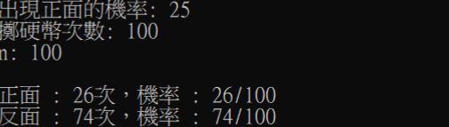
程式碼(C/C++)執行結果
02

Slide 10
3
Excel畫圖

Slide 11
03
03
01
用程式將所需的Data寫入Excel中。
04
02
計算出平均值與標準差。
套入NORM.DIST公式，計算出機率密度函數。
03
02
04
繪製直條圖與常態分佈圖。

Slide 12
4
成果展現

Slide 13
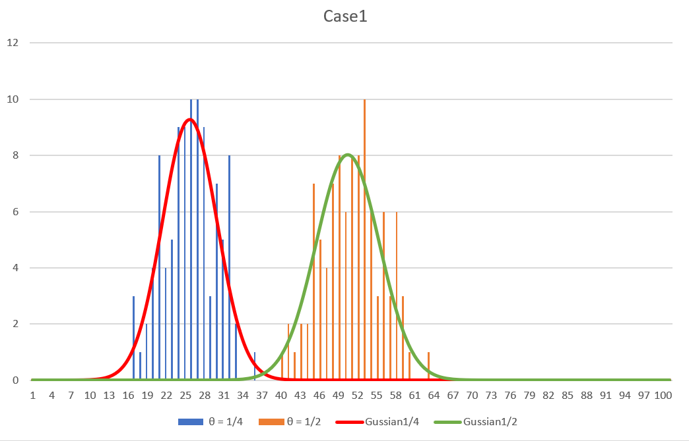
Case1

Slide 14
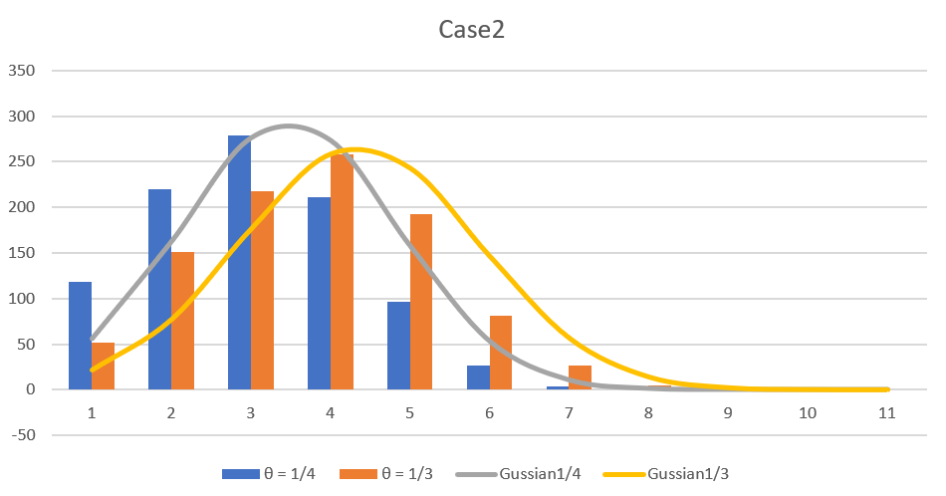
Case2

Slide 15
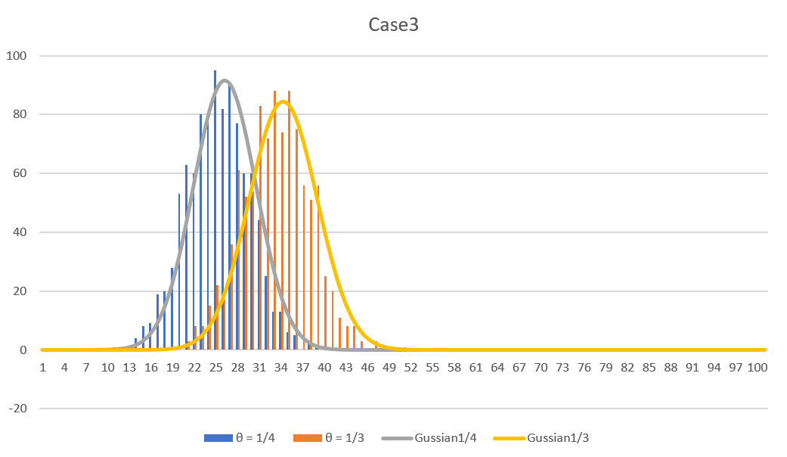
Case3

Slide 16
Thank You
.
.
.

